Slide 1
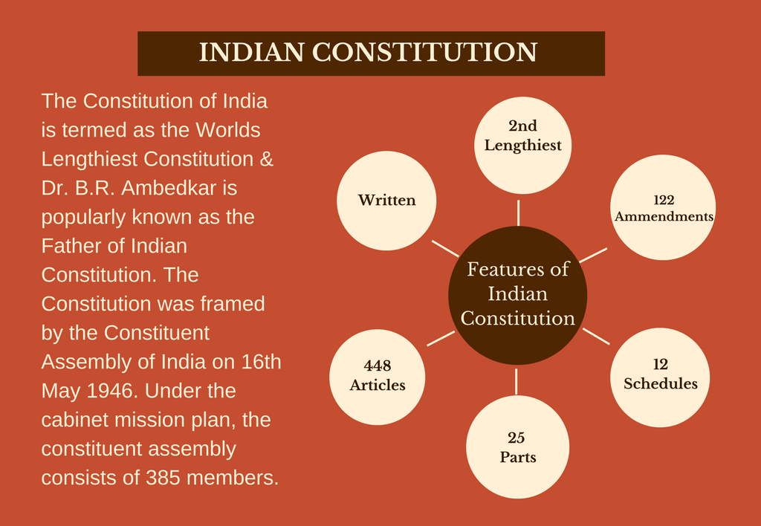

Slide 2
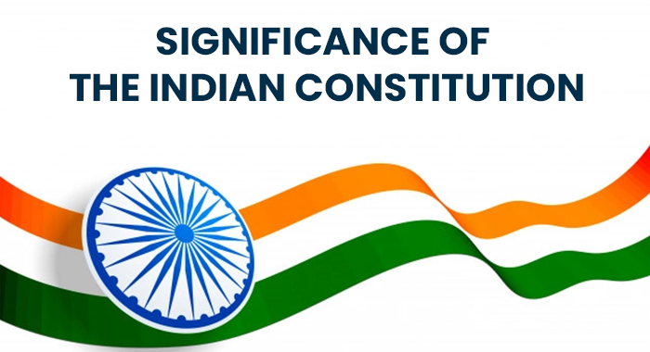
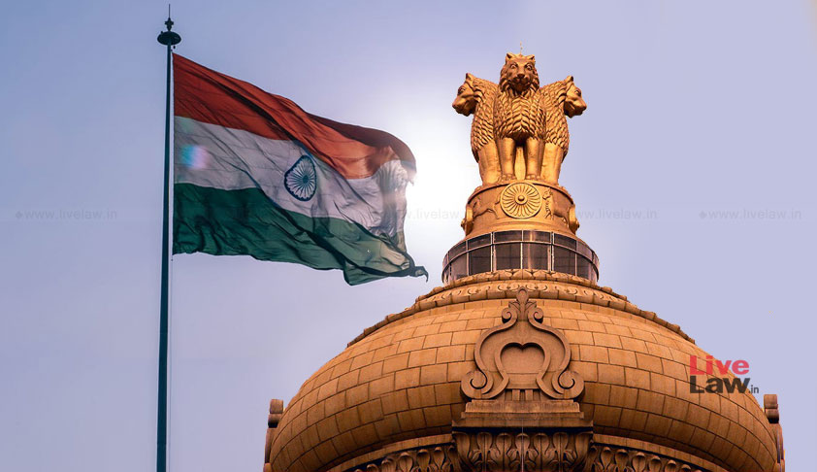

Slide 3
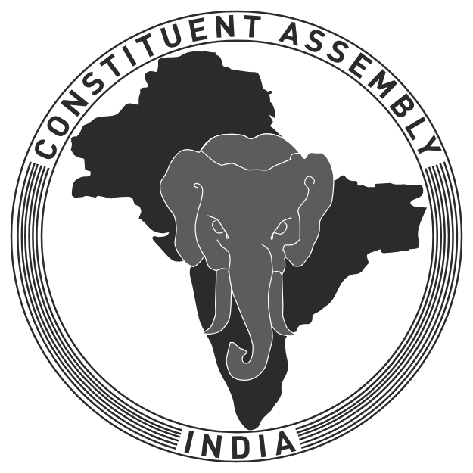
అఖండ భారత దేశం

Slide 4


Slide 5
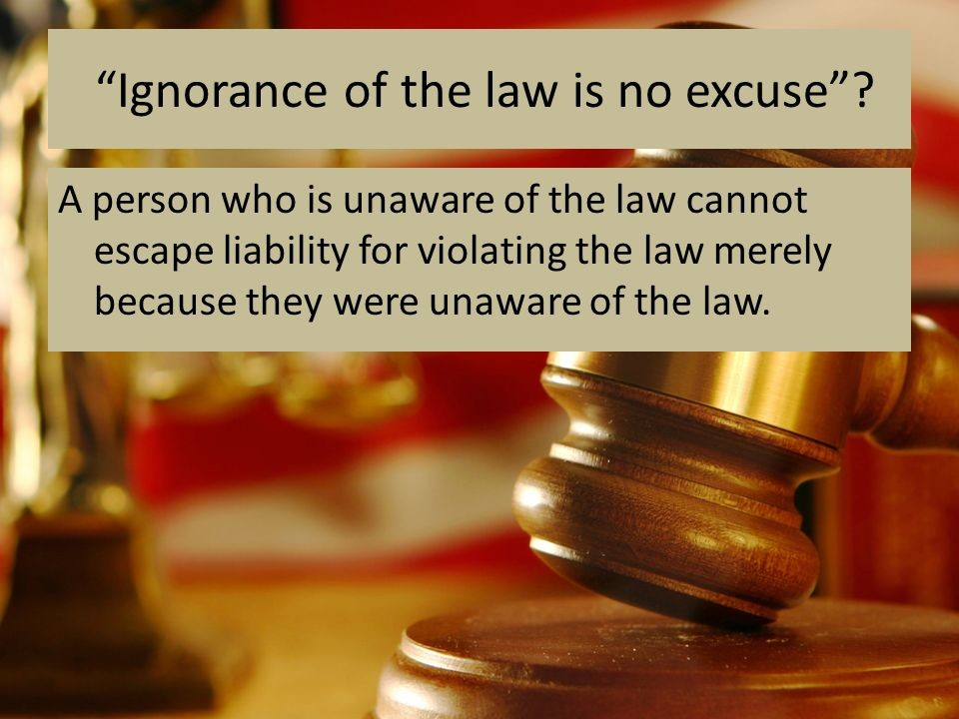

Slide 6
Professor & Lawyer
Puttu Guru Prasad
B.Com., M.Com., M.Phil., M.B.A., PGDFTM., AP.SET., M.Phil., DRMS., L.L.B.,
ICFAI TMF., DIRM., L.L.M., Pre PhD (PhD)from JNTUK., Topper
Domain Topper & 30th Batch Topper at ICFAI -2009 (TMF) LL.M Degree First Class with Distinction from ANU-2019
“Diploma in Psychology from YALE University”
MHRDI’s 'Institution's Innovation Council (IICs)Ambassador
NSS Certified Program Officer, (A.U)
LL.B Degree Gold Medallist from ANU-2005
ICFAI UNIVERSITY Trained Senior MBA Faculty
Eminent Faculty for Law, Accounts, Business Studies, Economics,
Head, Board of Administration & Management Science,
BHAGAVAD GITA & CLAT & IPMAT Program Coordinator,
Commerce Department, VIVA-VVIT, Nambur,
My Blog: puttuguru.blogspot.in My Web Site: https://gurublogs.wixsite.com/guru
93 94 96 98 98, 9885 96 36 36, 807 444 9539,

Slide 7
THE INDIAN CONSTITUTION: IMPORTANT THINGS YOU SHOULD KNOW
Professor & Lawyer Puttu Guru Prasad

Slide 8
Some of the Major Social Evils Prevailing in Society.
Gender Inequality.
Child Marriage.
Dowry system.
Bribe and corruption.
Adulteration.
Child Labor.
Caste system.

Slide 9
Women Empowerment And Constitutional Provisions
Women are now claiming socio-political rights (right to work, right to education, right to decide, etc.) for themselves.
The Parliament of India too has passed various legislations to save women from various forms of injustice and discrimination. To empower women there are some following laws :
Equal Remuneration Act-1976; Dowry Prohibition Act-1961;
Immoral Traffic (Prevention) Act-1956,
Medical termination of Pregnancy Act-1971;
Maternity Benefit Act-1961; Commission of Sati (Prevention) Act-1987;
Prohibition of Child Marriage Act-2006;
Pre-Conception & Pre-Natal Diagnostic Techniques (Regulation and Prevention of Misuse) Act-1994;
and Sexual Harassment of Women at Work Place (Prevention, Protection and) Act-2013.
Equal Property Rights and Struck down of Sec 497 of IPC (ADULTERY)

Slide 10
How Important Is the Constitution to an Engineering Graduates
An Engineer’s POV
“This is absolutely necessary as engineering is all about creating something, which has societal benefits. Unless you know society and its challenges, how will you produce something that’s required?
Engineering students in India will now have to study social sciences including management, environmental sciences, Indian culture, and Constitution according to a model curriculum by the All India Council for Technical Education (AICTE).
Engineering students need to follow a holistic approach and the programmes will have an inter-disciplinary approach. This will help in their overall growth and development,” the report quoted an AICTE official as saying.

Slide 11
Constitution of India Course Objectives
1. To Enable the student to understand the importance of the constitution
2. To understand the structure of executive, legislature, and judiciary
3. To understand the philosophy of fundamental rights and duties
4. To understand the autonomous nature of constitutional bodies like the Supreme Court and high court controller and auditor general of India and the election commission of India.
5. To understand the central and state relations, financial and administrative.

Slide 12
Constitution of India Course Outcomes
At the end of the semester/course, the student will be able to have a clear knowledge of the following:
1. Understand the historical background of the constitution-making and its importance for building a democratic India.
2. Understand the functioning of three wings of the government ie., executive, legislative, and judiciary.
3. Understand the value of the fundamental rights and duties for becoming a good citizen of India.
4. Analyze the decentralization of power between central, state, and local self-government.
5. Apply the knowledge in strengthening constitutional institutions like CAG, Election Commission, and UPSC for sustaining democracy.
6. Know the sources, features, and principles of the Indian Constitution.
7. Learn about Union Government, State government, and its administration.
8. Get acquainted with Local administration and Panchayati Raj.
9. Be aware of basic concepts and developments of Human Rights.
10. Gain knowledge of the roles and functioning of the Election Commission

Slide 14

Themis is the goddess and personification of justice, divine order, law, and custom.
The Latin Maxim:- 'Ignorantia legis neminem excusat,' or 'ignorance of the law is no excuse, and it is punishable’
It implies that the Court presumes that every party is aware of the law and hence cannot claim ignorance of the law as a defense to escape liability
Scales of Justice.

Slide 15
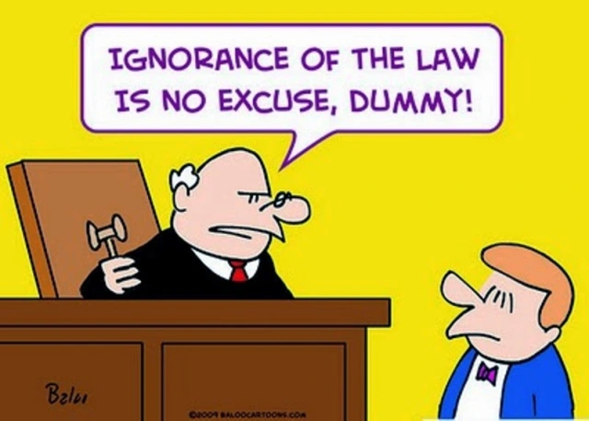

Slide 16

Before going to understand what is a Constitution, First, We will try to understand what is a RULE? and its implications
Rules are meant for everyone.
They apply equally to all.
Disobeying the rules leads to punishment.
There is no discrimination in punishments for breaking the rules.

Slide 17
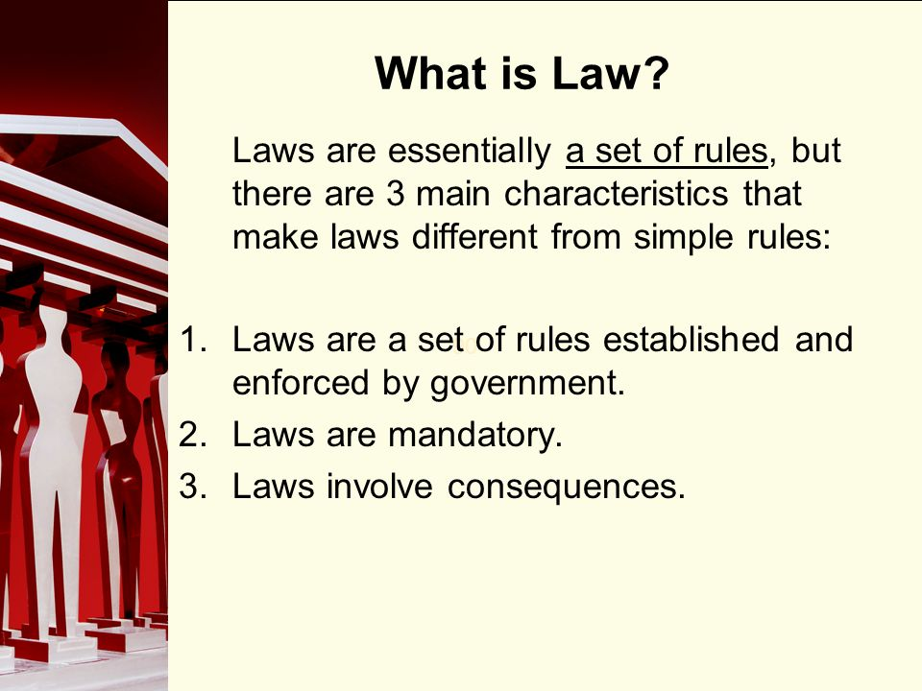

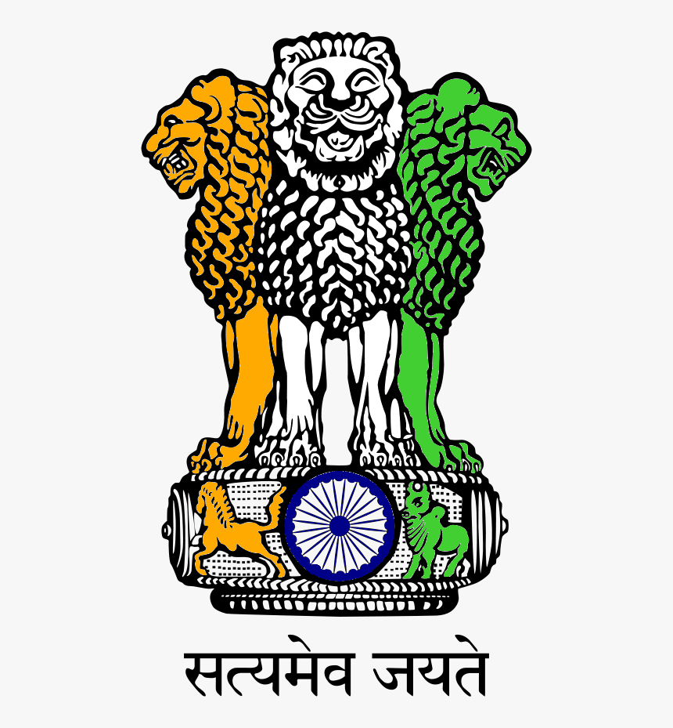


Slide 18
Need for a Constitution
for Engineering Graduates

Slide 19

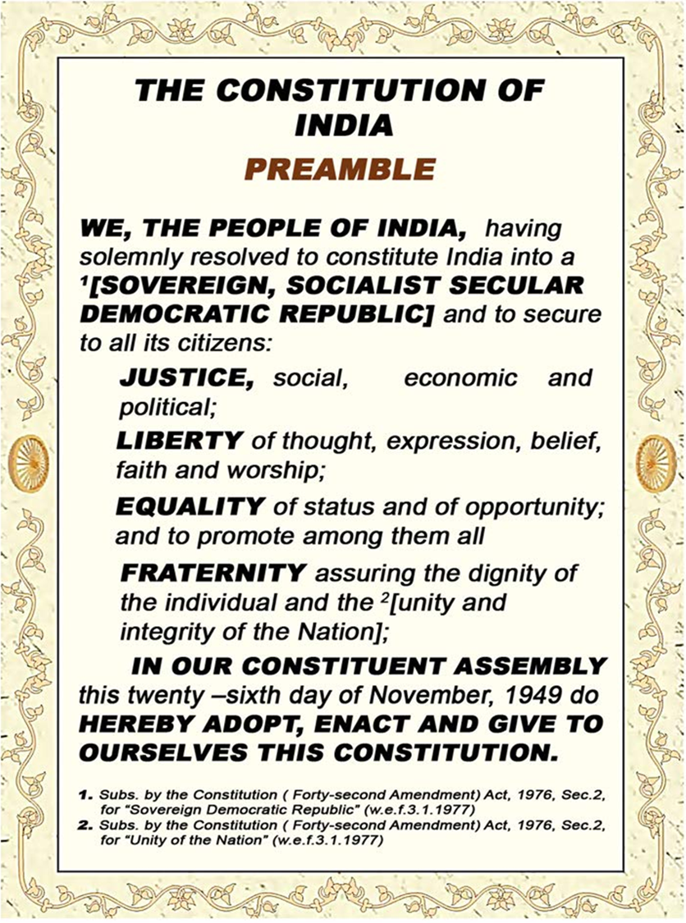
SET of RULES of a School is called Discipline ******************* SET of RULES of a Country is called Constitution

Slide 20
GENERAL RULES AND REGULATIONS
for Engineering College Students

Slide 21
All students should reach the classroom on time and shall not leave the class without the permission of the teacher. Every student should carry his/ her identity card and produce it on demand by the authorities. | Any unhealthy relationship between students that might affect their academic performance, breach their personal space or affect the reputation of the institution will be strictly dealt with.
All students should wear proper uniforms with shoes. The College campus is a no–smoking/ alcohol-free zone. | Students shall keep themselves informed of the instructions issued to them from time to time orally or through notices/ circulars and emails.
The behavior of the students, both within and outside the college premises should be decent and befitting to a professional institution. | Students are expected to contribute towards the academic/ social/environmental initiatives that the Institute may undertake.
All expressions or activities which are immoral, antisocial, communal and anti-national are strictly prohibited in the College campus. | For outstation programmes including study tour, the students are required to submit a permission letter from their parents.
Students found guilty of ragging will be dismissed from the college as per the Supreme Court ruling | Students are required to keep safe custody of their valuables. They should maintain decency and decorum during cultural events, be it inside the campus or outside.
Students are prohibited to bring or use mobile phones within the campus. | This, being an eco–friendly campus, plastic or other trash should not be thrown inside the college or in the premises

Slide 22



Protecting the weak from the strong

Slide 23
A set of Rules of a Country is known as the Constitution.
Laws are mandatory means, If an action or procedure is mandatory, people have to do it because it is a rule or a law.
Legal Consequence means, the result of an action that directly or indirectly affects substantive legal rights or obligations. Legal Implications mean, the results or consequences of being involved in something according to the law. A good example is the case of marriage. As a consequence of being married, all property is considered co-owned as long as you acquired it after you got married.

Slide 24




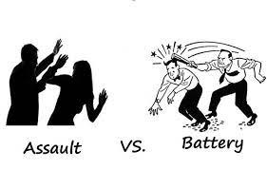
CRIMINAL INTIMIDATION
ROUMORS & GOSSIPS
EVILS of SOCIETY

Slide 25



Slide 26
UNIT-I
Introduction to Indian Constitution: “Constitution” meaning of the term, Indian Constitution – Sources and constitutional history, Features - Citizenship, Preamble, Fundamental Rights and Duties, Directive Principles of State Policy.
UNIT-II
Union Government and its Administration Structure of the Indian Union: Federalism, Centre-State relationship, President: Role, power and position, PM, and Council of ministers, Cabinet and Central Secretariat, Lok Sabha, Rajya Sabha, The Supreme Court and High Court: Powers and Functions;
UNIT-III
State Government and its Administration Governor - Role and Position - CM and Council of Ministers, State Secretariat: Organization, Structure, and Functions
UNIT-IV
Local Administration - District’s Administration Head - Role and Importance, Municipalities -Mayor and role of Elected Representative - CEO of Municipal Corporation Panchayats: Functions PRI: Zila Panchayat, Elected officials and their roles, CEO Zila Panchayat: Block level Organizational Hierarchy - (Different departments), Village level - Role of Elected and Appointed officials - Importance of grass root democracy
UNIT-V
Election Commission: Election Commission- Role of Chief Election Commissioner and Election Commissioner ate State Election Commission: Functions of Commissions for the welfare of SC/ST/OBC and women

Slide 27
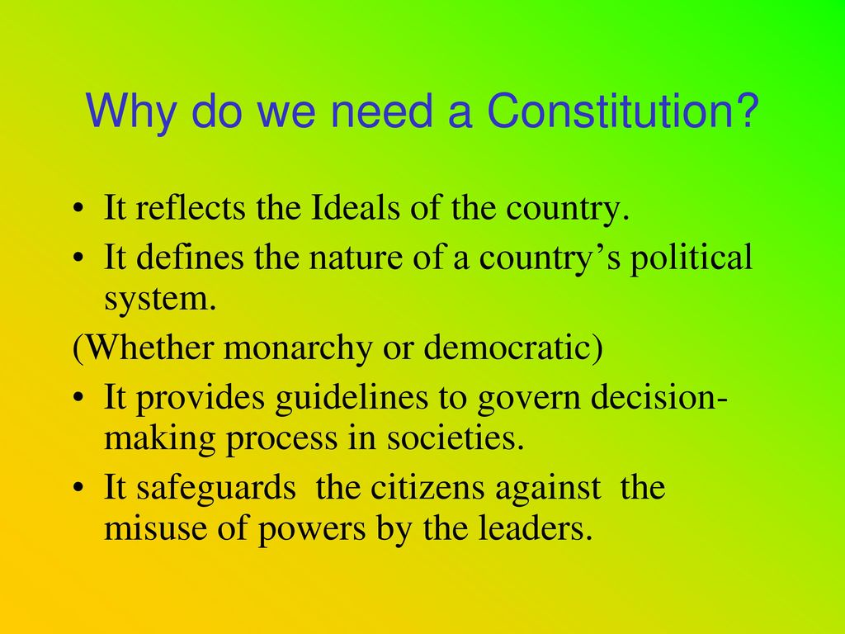

Slide 28
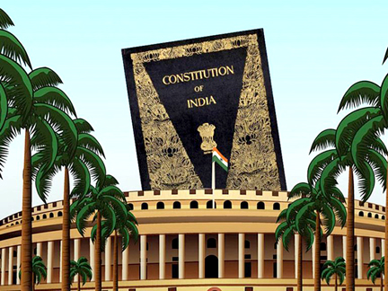

Slide 29
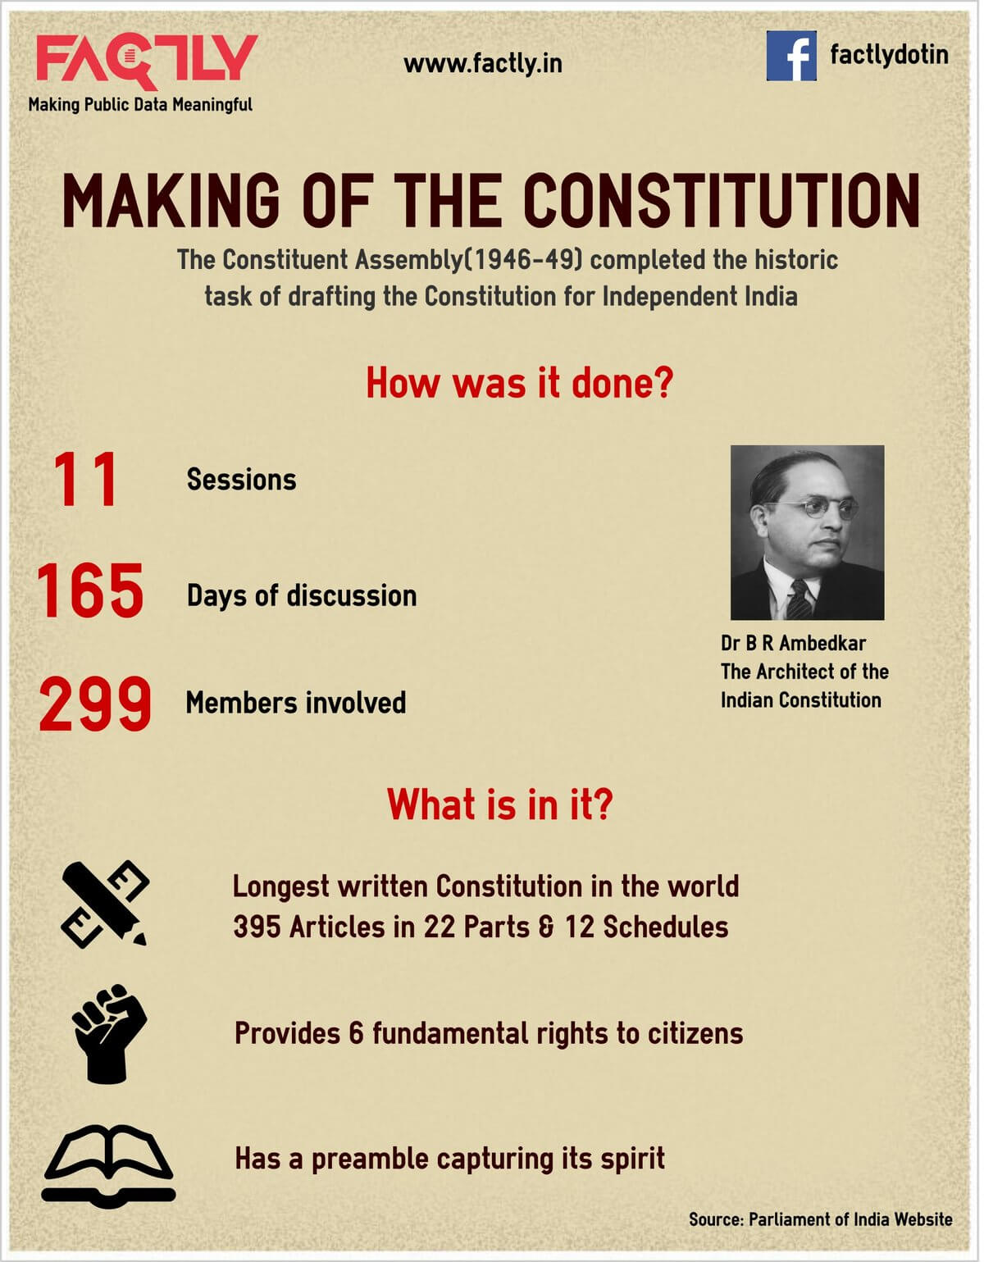
Meaning of Constitution
The term constitution comes from French from the Latin word constitutio, used for regulations and orders, such as imperial enactments.
A constitution is primarily a set of rules and principles specifying how a country should be governed, how power is distributed and controlled, and what rights citizens possess. It can also be said as the fundamental law of the country.

Slide 30

PREAMBLE
WE, THE PEOPLE OF INDIA, having solemnly resolved to constitute India into a SOVEREIGN SOCIALIST SECULAR DEMOCRATIC REPUBLIC and
to secure to all its citizens:
JUSTICE, social, economic and political;
LIBERTY of thought, expression, belief, faith and worship;
EQUALITY of status and of opportunity and to promote among them all;
FRATERNITY assuring the dignity of the individual and the unity and integrity of the Nation;
IN OUR CONSTITUENT ASSEMBLY this twenty sixth day of November, 1949, do HEREBY ADOPT, ENACT AND GIVE TO OURSELVES THIS CONSTITUTION.

Slide 31
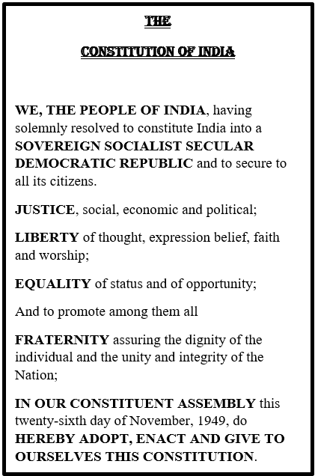
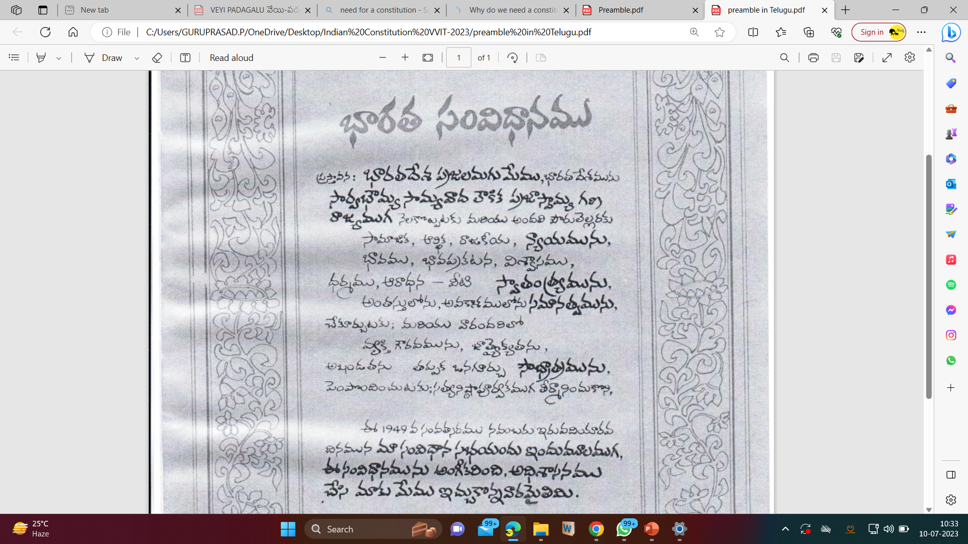

Slide 32
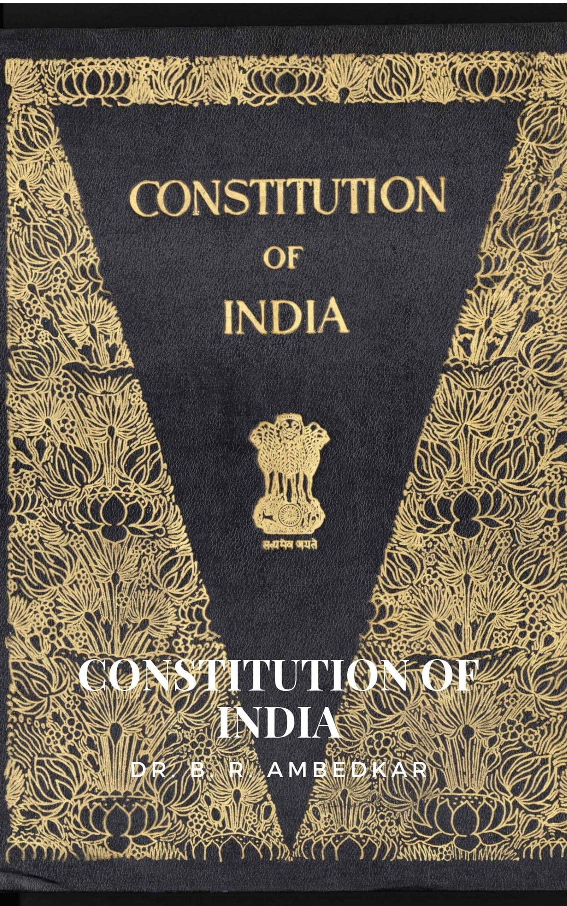
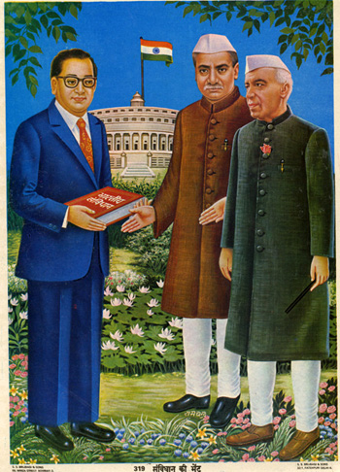

Slide 33
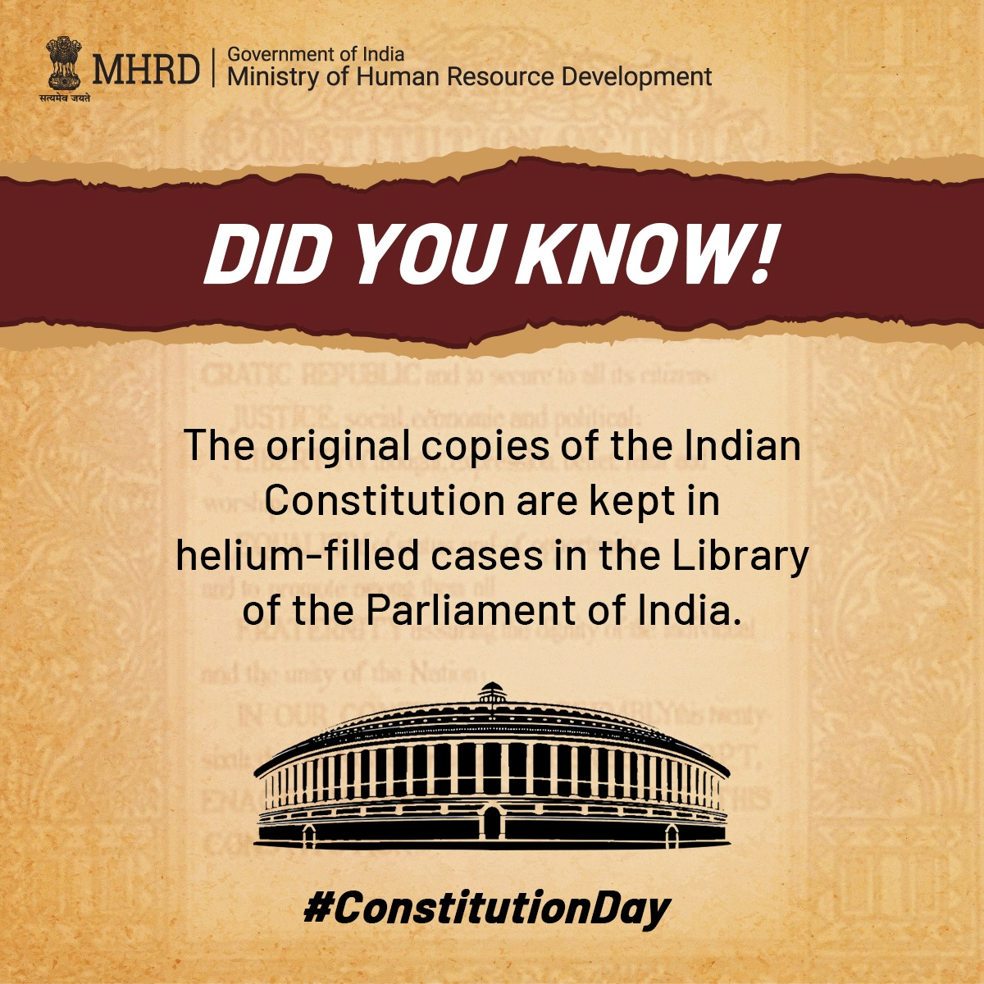
The original Constitution of India was handwritten by Prem Behari Narain Raizada in a flowing italic style with beautiful calligraphy. The Constitution was published in Dehradun and photolithographed by the Survey of India. Each page was uniquely decorated by artists from Shantiniketan including Beohar Rammanohar Sinha and Nandalal Bose.

Slide 34
అఖండ భారత దేశం

Slide 35
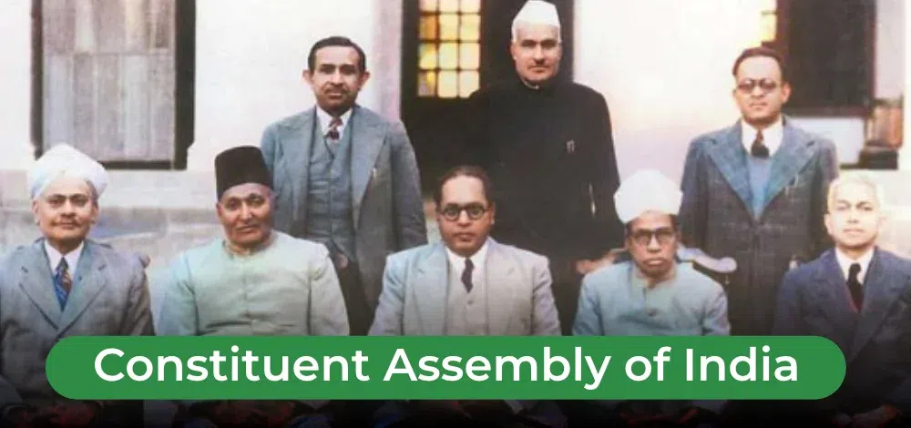
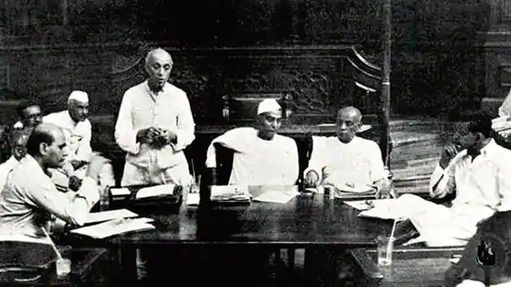
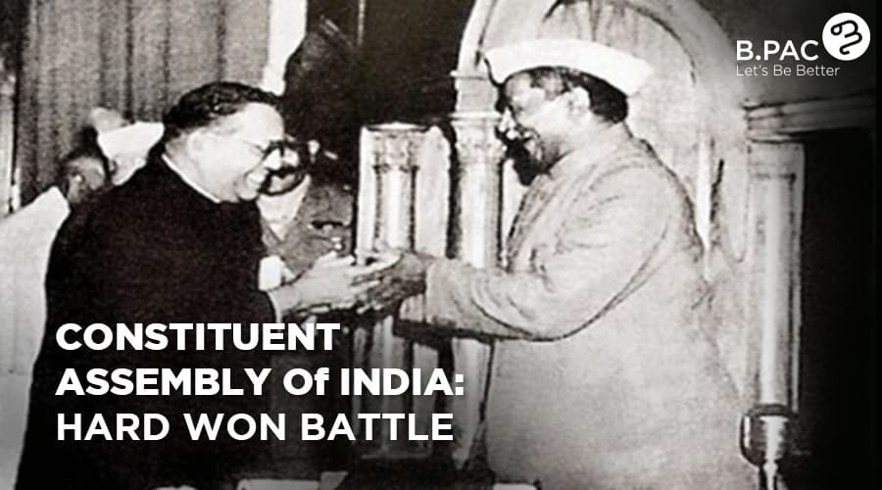

Slide 36
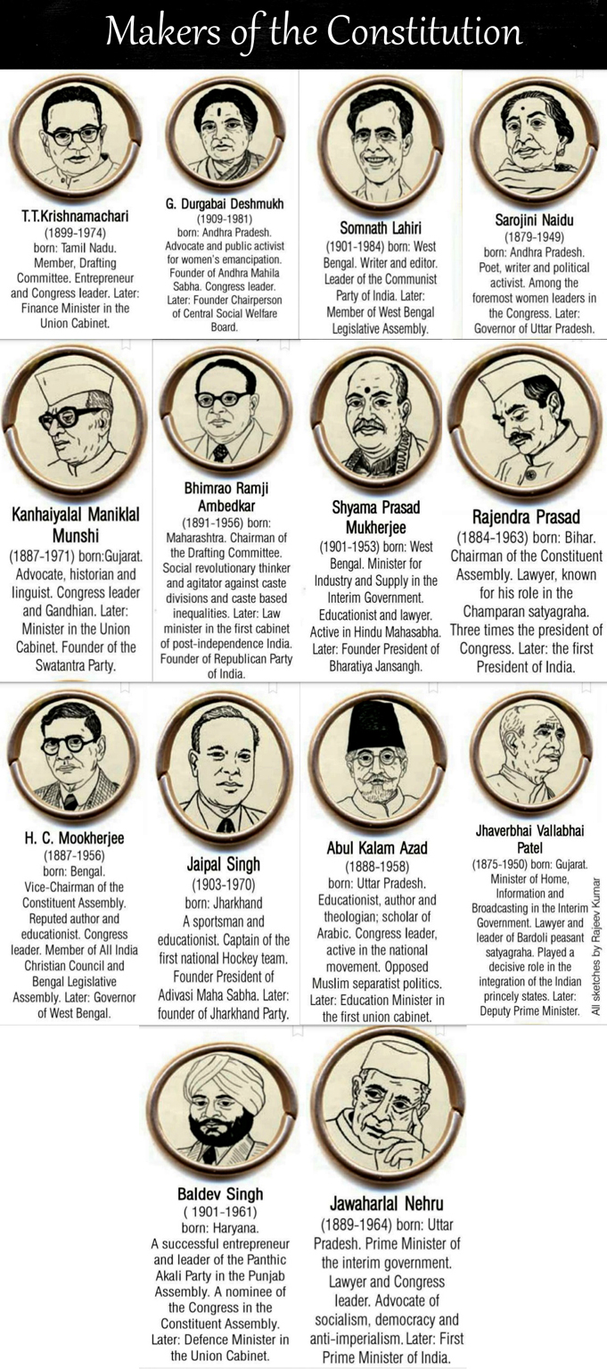
Sovereign
The term Sovereign which is proclaimed by the Preamble means that India has its own independent authority and it is not a dominion of any other external power.
In the country, the legislature has the power to make laws which are subjected to certain limitations.*

Slide 37
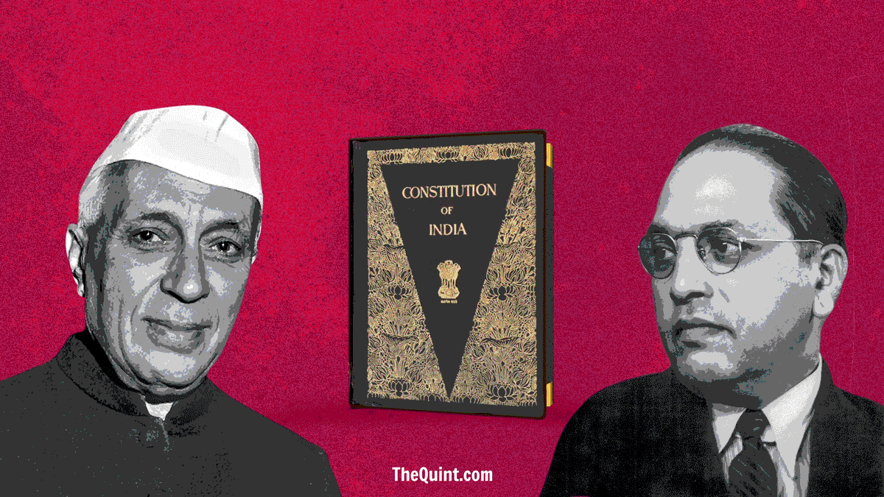

Slide 38
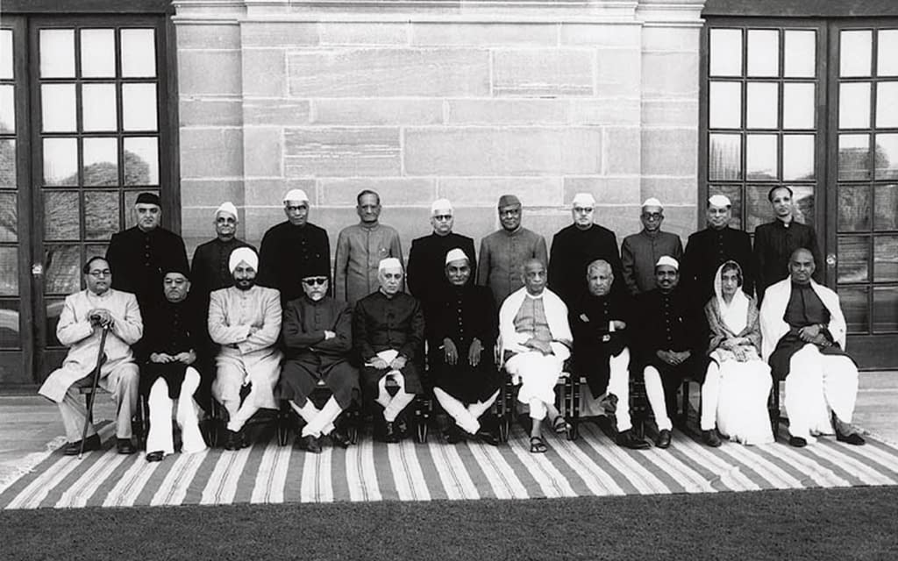
Formation of the
Constituent Assembly

Slide 39
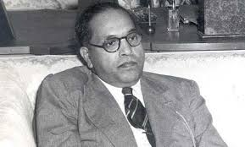

BR. Ambedkar
The Chief architect of Indian Constitution

Slide 40
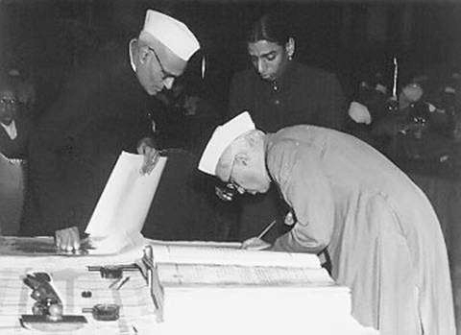

ARCHITECTS OF THE INDIAN CONSTITUTION
Pt. Nehru signing on the Constitution

Slide 41
Introduction
Every year on 26th November, Constitution Day is celebrated in the country.
Constitution Day (or Samvidhan Divas), also known as National Law Day, is celebrated to commemorate the adoption of the Constitution of India.
On 26 November 1949, the Constituent Assembly of India adopted the Constitution of India, and it came into effect on 26 January 1950.
The Government of India declared 26 November as Constitution Day on 19 November 2015 by a gazette notification.
The year 2015 was the 125th birth anniversary of Dr. B.R Ambedkar, who had chaired the drafting committee of the Constituent Assembly.
He played a pivotal role in the drafting of the Constitution. Previously this day was celebrated as Law Day.
This is a day to express gratitude to the makers of our Constitution and to reiterate our commitment to building the India of their dreams.”

Slide 42
Why do we need a Constitution?
Almost every aspect of our lives is governed by a set of rules. Think of your games; almost everyone has their own specific regulations; your schools have certain rules that you have to follow.
Adults are not exempt from rules; workplaces have them. Some are imposed by custom and tradition.
Similarly, society also needs certain rules so that people can live together in a safe manner.
These are called Laws and are made by legislatures like our Parliament. The Constitution is the supreme law of the country and it contains laws concerning the government and its relationships with the people.
This quote by Patrick Henry, an American lawyer and politician, sums up the power of a Constitution best: “The Constitution is not an instrument for the government to restrain the people; it is an instrument for the people to restrain the government.”

Slide 43
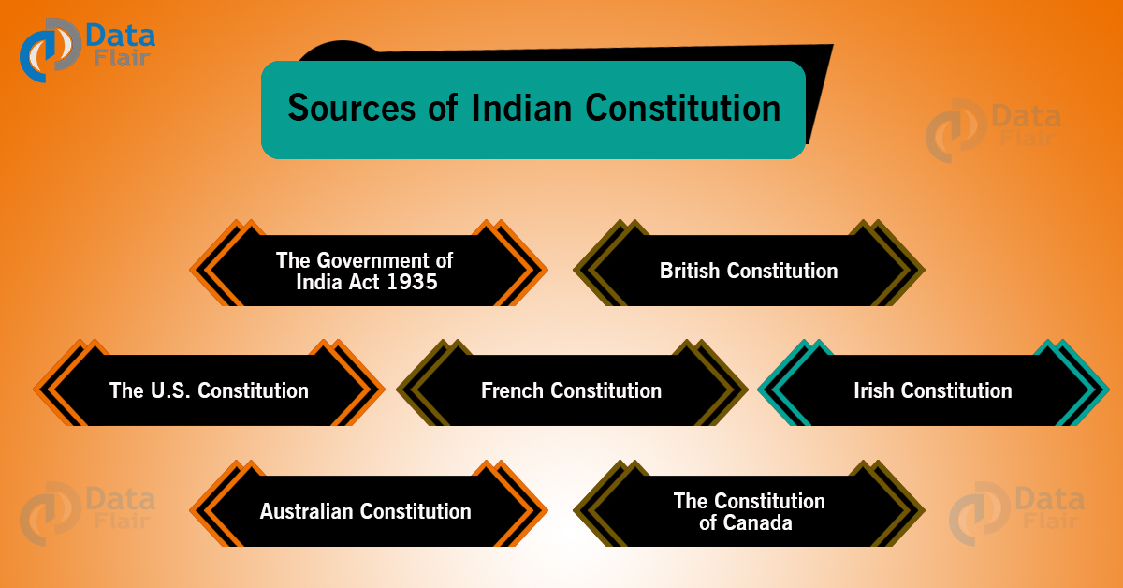

Slide 45
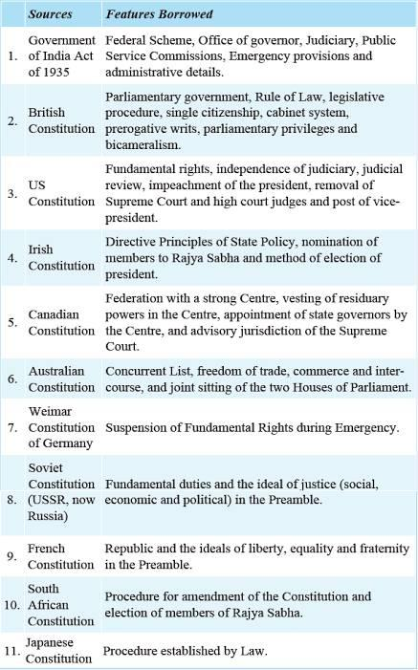

Slide 47
Background of Constituent Assembly of India
India was still under British rule when the Constituent Assembly was established, following negotiations between Indian leaders and members of the 1946 Cabinet Mission to India from the United Kingdom.
Provincial assembly elections were held in early 1946. Constituent Assembly members were elected indirectly by members of the newly elected provincial assemblies, and initially included representatives for those provinces that formed part of Pakistan (some of which are now in Bangladesh).
The Constituent Assembly had 389 representatives, including fifteen women. (which declined to 299 after the partition)

Slide 48
Timeline of Formation of 'The Constitution of India'
9 December 1946: Formation of the Constituent Assembly (demanding a separate state, the Muslim League boycotted the meeting)
11 December 1946: President Appointed – ⁣Rajendra Prasad, vice-chairman Harendra Coomar Mookerjee and constitutional legal adviser B. N. Rau (initially 389 members in total, which declined to 299 after partition. Out of 389, 292 were from government provinces, 4 from chief commissioner provinces and 93 from princely states)
13 December 1946: An 'Objective Resolution' was presented by Jawaharlal Nehru, laying down the underlying principles of the constitution, which later became the Preamble of the constitution.
22 January 1947: Objective resolution unanimously adopted.
22 July 1947: National flag adopted.
15 August 1947: Achieved independence. India split into the Dominion of India and the Dominion of Pakistan.
29 August 1947: Drafting Committee was appointed, with Dr. B. R. Ambedkar as the chairman. Other 6 members of the Committee
16 July 1948: Along with Harendra Coomar Mookerjee, V. T. Krishnamachari was also elected as the second vice-president of the Constituent Assembly.
26 November 1949: 'Constitution of India' passed and adopted by the assembly.
24 January 1950: Last meeting of the Constituent Assembly. 'Constitution of India' (with 395 articles, 8 schedules, 22 parts) was signed and accepted by all.
26 January 1950: The 'Constitution of India' came in to force after 2 years, 11 months and 18 Days, at a total expenditure of ₹6.4 million to finish.

Slide 49
The Preamble: What does it say, and what does it mean?
A preamble is an introductory statement in a document that explains the document’s philosophy and objectives.
In a Constitution, it presents the intention of its framers, the history behind its creation, and the core values and principles of the nation.
The Preamble basically describes the source, nature, ideology, goals and objectives of the Constitution.
The ideals behind the Preamble to India’s Constitution were laid down by Jawaharlal Nehru’s Objectives Resolution, adopted by the Constituent Assembly on January 22, 1947.
Although not enforceable in court, the Preamble states the objects of the Constitution, and acts as an aid during the interpretation of Articles when language is found ambiguous.

Slide 50
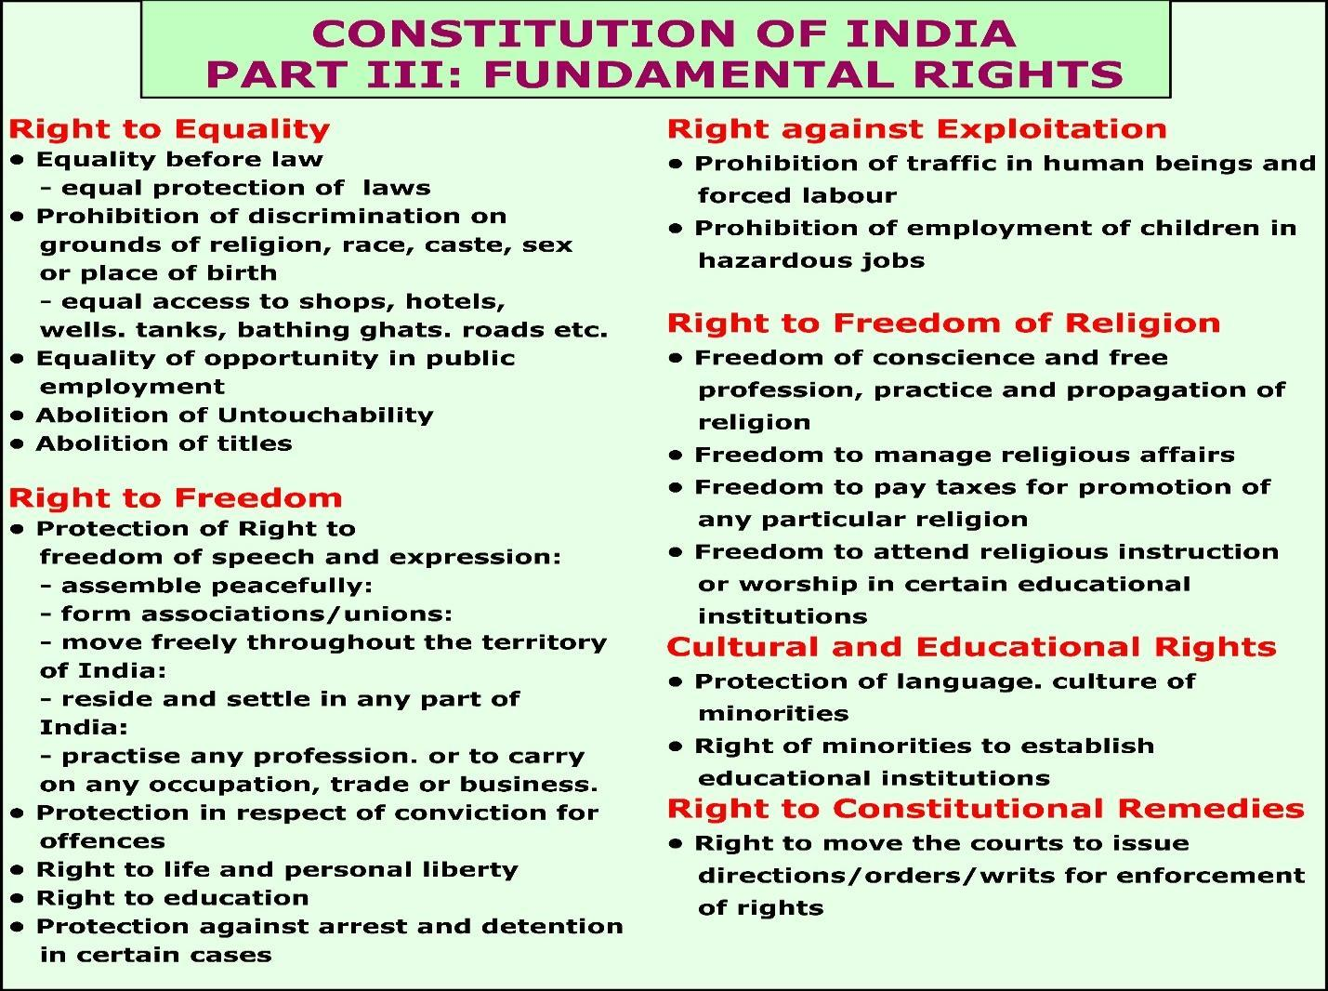

Slide 51
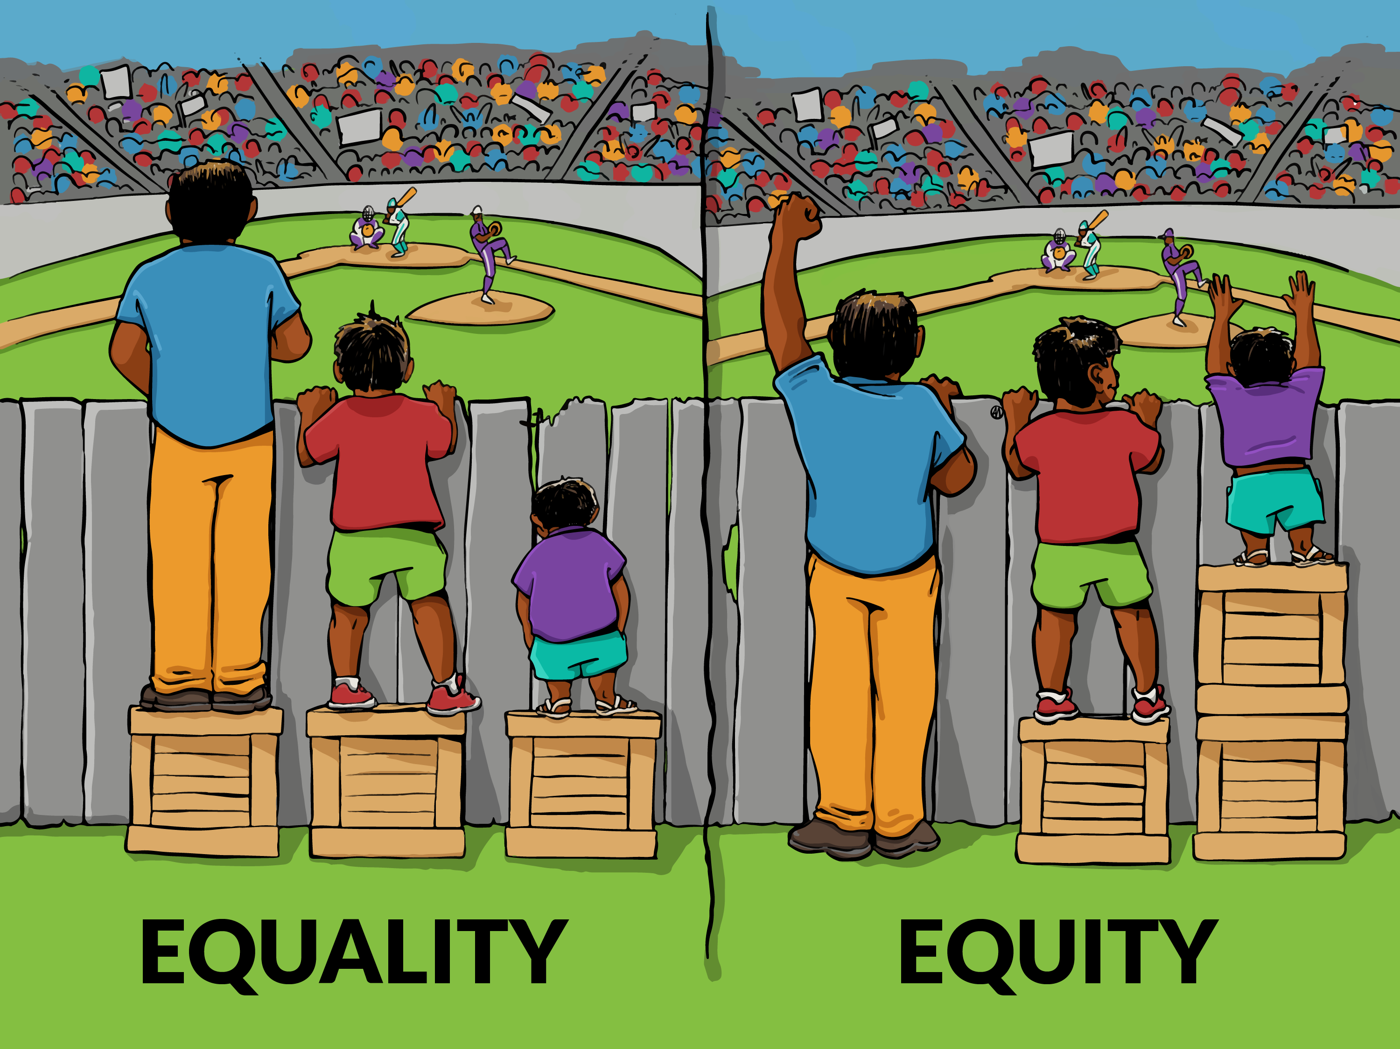

Slide 52


Slide 53
In the words of B.R. Ambedkar,
“Constitution is not a mere lawyer’s document, it is a vehicle of Life, and its spirit is always the spirit of Age.”
In every country, the interests of the citizens must always be given their due weight and must be protected from the arbitrary actions of those in power.
It is crucial for a country to have its sovereignty intact to have political stability.
That is, the relationship between the states and the subjects and also among the subjects, and the subjects should be properly defined.
A constitution is essentially a tool to ensure the political stability of a state.

Slide 54
Indian Constitution
India’s Constitution is the supreme law of India. It defines the Government’s fundamental political values, policies, processes, powers, rights, and duties.
It conveys constitutional supremacy & not parliamentary supremacy because it is not established by the Parliament but by a constituent assembly and adopted by its citizens, with a declaration in its preamble.

Slide 55
About the Indian Constitution
The Constitution of India is the longest Constitution in the world.
It had (395) three ninety-five articles in (22) twenty-two parts and (8) eight schedules at its beginning.
It comprises of around 145,000 words making it the world’s second-largest functioning constitution.
It currently has a preamble, (25) twenty-five parts with, (12) twelve schedules (5) five appendices, (448) four forty-eight articles& (101) hundred and one amendments.

Slide 56
Why do we need a constitution?
It is important to have a Constitution for the following reasons:
It is a significant rule of the nation. The relationship of people with governments is decided by this.
It sets down standards and procedures that are necessary to live in peace for individuals belonging to various religious groups.
It sets out how the government will be chosen and who will have the authority and duty to decide things.
It defines the parameters of the government’s control and informs us about people’s rights.
It reflects the desires of individuals to create a good society.

Slide 57


